Slide 1
Fake News Detection on Social Media
Team Guide:
G. S. Ramesh
Assistant Professor
Dept.of CSE
Team Members:
K H S Supriya - 19071A05E8
P Akash - 19071A05G5
A Rukmananda Reddy - 19071A05G6
V Tejaswini - 19071A05H9

Slide 2
Agenda
Abstract
Introduction
Literature Survey
Existing System
Proposed System
System Requirements
Future Scope

Slide 3
Abstract
Fake news has been there since before the advent of the Internet. It can be defined as “fictitious articles deliberately fabricated to deceive readers”.
With the current usage of social media platforms, consumers are creating and sharing more information than ever before, some of which are misleading with no relevance to reality.
Social media and news outlets publish fake news to increase readership or as part of psychological manipulation. In general, the goal is profiting through click baits to lure users and entice curiosity with flashy headlines or designs to click links to increase advertisements revenues.
The purpose of this project was to create a tool for detecting the language patterns that characterize fake and real news through the use of machine learning and natural language processing techniques. The results of this project demonstrate the ability of machine learning to be useful in this task.

Slide 4
Introduction
In modern era where the internet is ubiquitous, everyone relies on various online resources for news.
Along with the increase in the use of social media platforms like Facebook, Twitter etc. news spread rapidly among millions of users within a very short span of time.
Fake news encapsulates pieces of news that may be hoaxes and is generally spread through social media and other online media.
Such news items may contain false and/or exaggerated claims, and may end up being viralised by algorithms, and users may end up in a filter bubble.
The spread of fake news has far-reaching consequences like the creation of biased opinions to swaying election outcomes for the benefit of certain candidates.

Slide 5
Literature Survey
S.No | Title | Methodology/Algorithm | Pros/cons | Year
1 | A HYBRID APPROACH TO FAKE NEWS DETECTION ON SOCIAL MEDIA | The Hybrid Model - Machine-Human based system. Combining the human based social media news literacy education tool and the machine based approaches for linguistic and network analyses. | Parallel approaches of detection at work Need a lot of databases Do not work for small population | 2018
2 | A SURVEY ON NATURAL LANGUAGE PROCESSING FOR FAKE NEWS DETECTION | Machine Learning Models(supervised) Non-Neural Network Models(SVM,Naive Bayes) Neural Networks(RNN,LSTM) |  | 2020

Slide 6
Literature Survey
S.No | Title | Methodology/Algorithm | Pros/cons | Year
3 | DETECTING FAKE NEWS IN SOCIAL MEDIA NETWORKS | Web Crawling to collect URLS for the Clickbaits. Extract features from the web pages - A python script compute the attributes from the title and content of the web pages. | Used to detect and filter out potential Clickbaits. Used only to detect Clickbaits using URL. | 2018
4 | FAKE NEWS DETECTION ON SOCIAL MEDIA - A DATA MINING PERSPECTIVE | Feature extraction Model Construction Classification | We cannot extract all relevant features Only one model is used to detect fake news | 2019

Slide 7
Literature Survey
S.No | Title | Methodology/Algorithm | Pros/cons | Year
5 | A COMPREHENSIVE REVIEW ON FAKE NEWS DETECTION WITH DEEP LEARNING | Deep Learning Methods CNN RNN GNN GAN BERT | Long textual features can be easily extracted by RNN. We cannot combine multiple features. | 2021
6 | FAKE NEWS DETECTION USING MACHINE LEARNING ENSEMBLE METHODS | Logistic Regression Support Vector Machine Multilayer Perceptron Ensemble learners | XGBoost - it’s very much useful in identifying errors and minimizing them in each iteration. | 2020

Slide 8
Literature Survey
S.No | Title | Methodology/Algorithm | Pros/cons | Year
5 | FAKE NEWS DETECTION USING MACHINE LEARNING | Methodology uses a dataset to build a decision model based on Support Vector Machine. The model is then used to classify novel news to fake or real. | Gives better recognition rate Gives each information a degree of confidence. | 2020
6 | EFFECTIVE FAKE NEWS DETECTION USING GRAPH AND SUMMARISATION TECHNIQUES | Graph construction using attention mechanism Sentence extraction using the summarisation technique Updating context graph | As the graph was updated by increasing no. of iterations, the performance of our model becomes worse. This is because of spread of noisy features | 2021

Slide 9
Existing System
The existing system consists of methods to detect the fake news using machine learning algorithms.
But the existing system detects the fake news by using only one model or several models one at a time. The existing system do not take the advantages of machine learning models when they are combined into one model by which we can achieve high accuracy.

Slide 10
Proposed System
Due to the complexity of fake news detection in social media, it is evident that a feasible method must contain several aspects to accurately tackle the issue.
This is why the proposed system is a combination of Naive Bayes Classifier, Support Vector Machines and Decision Tree. The Three-part method is a combination between Machine Learning Algorithms that subdivide into supervised learning techniques, and natural language processing methods.
Although each of these approaches can be solely used to classify and detect fake news, in order to increase the accuracy and be applicable to the social media domain, they have been combined into an integrated algorithm as a method for fake news detection.

Slide 11
System Requirements
Hardware Requirements
Processor: i3,i5,i7 and above
Ram: 4gb and above
Software Requirements
Python 3.7
Jupyter Notebook

Slide 12
Functional Requirements
Take a valid dataset
Extract relevant data from dataset
Extract relevant features from the text using NLP.
Non-Functional Requirements
Feature extraction must be done in milliseconds
Time taken by ML Algorithms should be less(in ms)
Response Time should be high

Slide 13
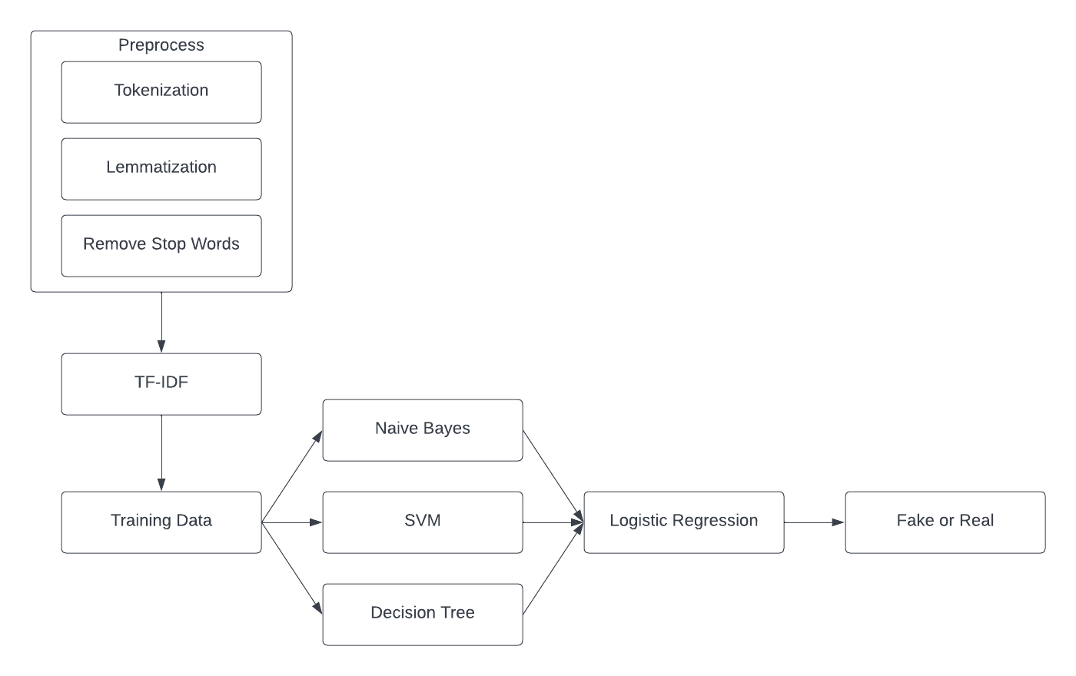
System Architecture

Slide 14
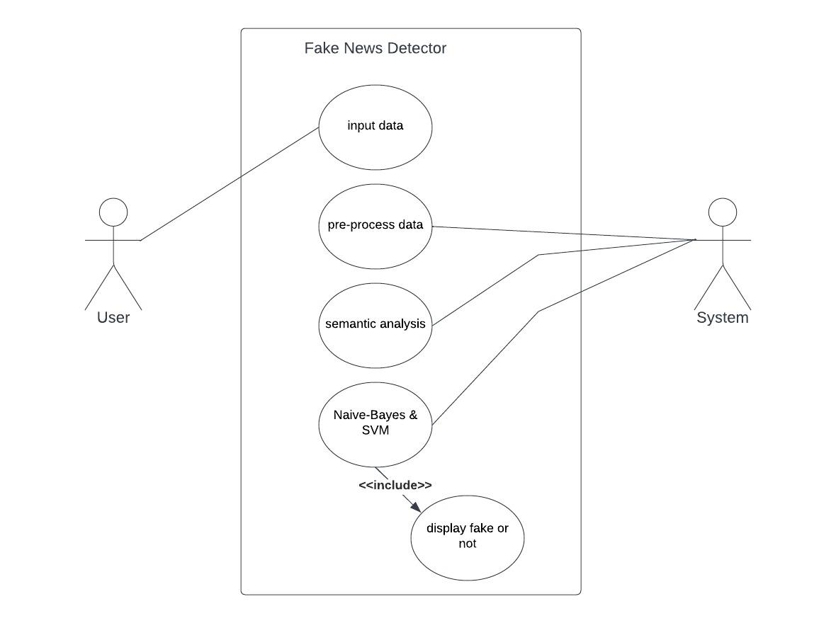
Use Case Diagram

Slide 15
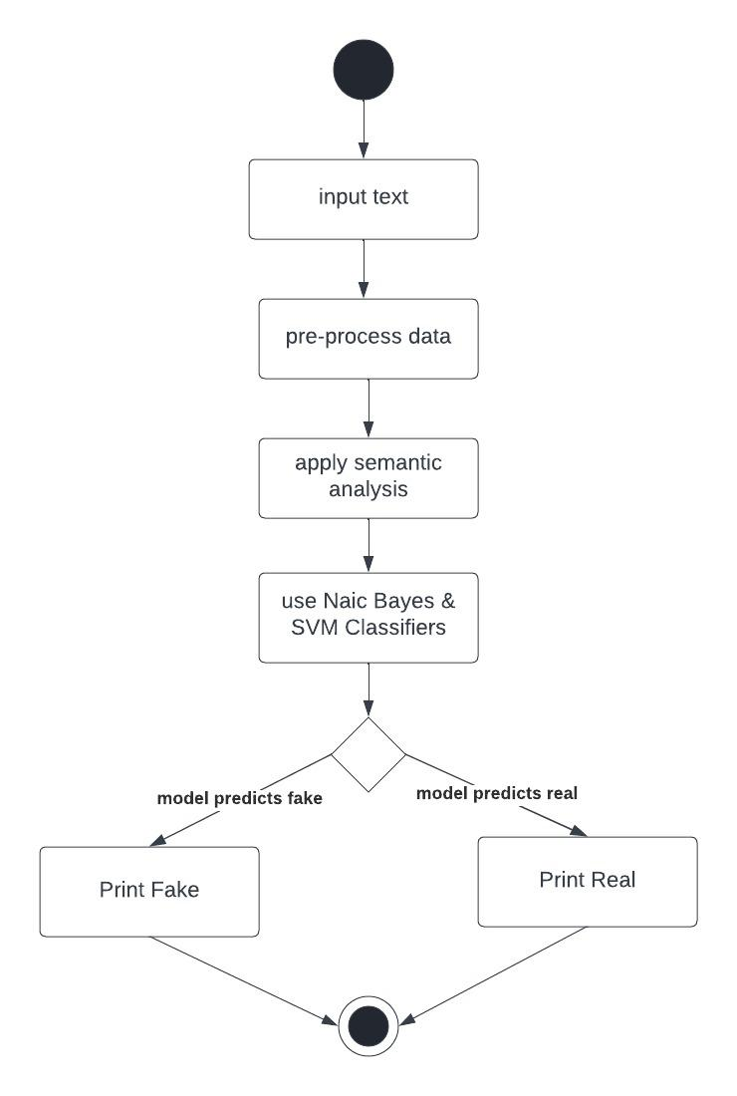
Activity Diagram

Slide 16
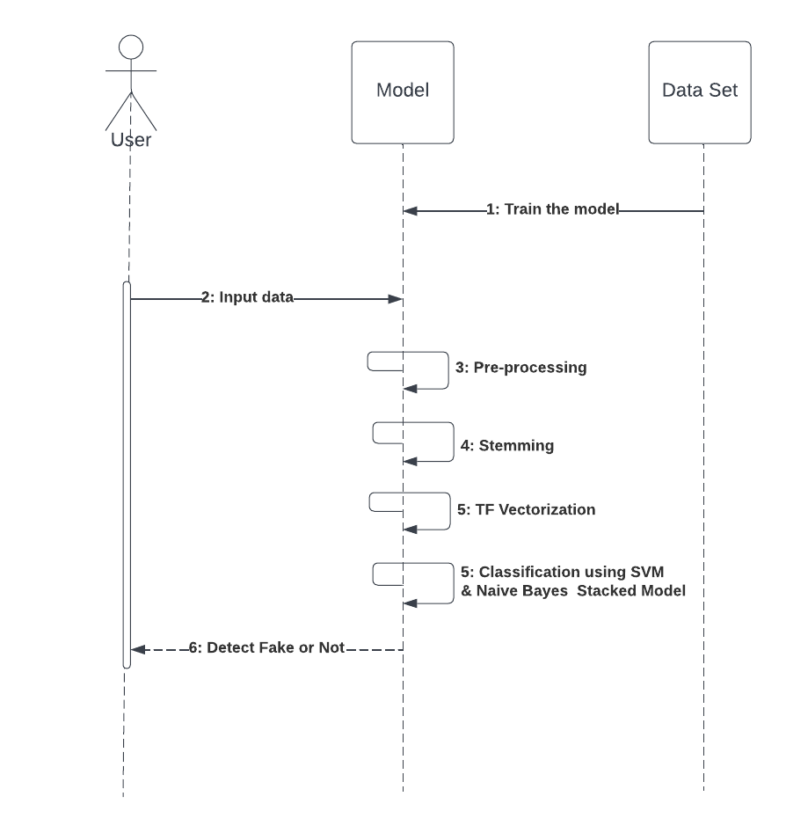
Sequence Diagram

Slide 17
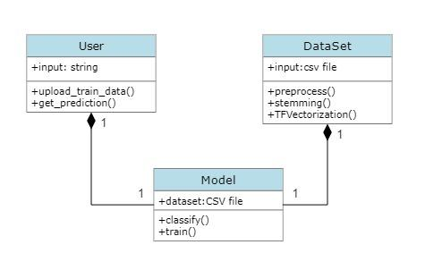
Class Diagram

Slide 18
Future Scope
The project can be extended to combine machine learning algorithms with advantages of blockchain peer-to-peer networking concepts.
We can also extend our project to detect the abusive words used in social media with our ML algorithms.
An ambitious work would be to search the news on the internet and compare the search results with the original news.

Slide 19
Thank you

